Slide 1
Project Title-Brain Tumor Segmentation using Mask R-CNN
Guide-Prof. Abir Das Project Presentation by
21MM61R18 Rohit Kumar
1

Slide 2
INTRODUCTION
01
MODEL ARCHITECTURE
02
CONTENTS of this Presentation
RESULTS
03
04
CHALLENGES FACED AND THEIR SOLUTION
2

Slide 3
01
INTRODUCTION
3

Slide 4
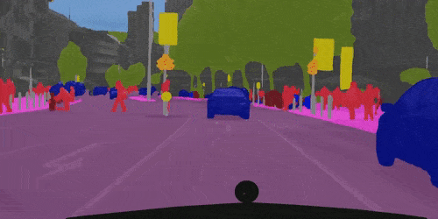
Introduction
Why Image Instance Segmentation ?
Medical Robotics
Tumor segmentation
Augmented Reality
4

Slide 5
Introduction
Key Factors
01
CNN->RPN->ROI->FC Layers->Object Mask Prediction
Pipeline
02
BRATS (The Multimodal Brain Tumor Image Segmentation Benchmark), Glioma Segmentation Challenge
Datasets
03
Mask R-CNN= Object Detection(Fast R –CNN)+
FC Network(Mask generator)
Methods
5

Slide 6
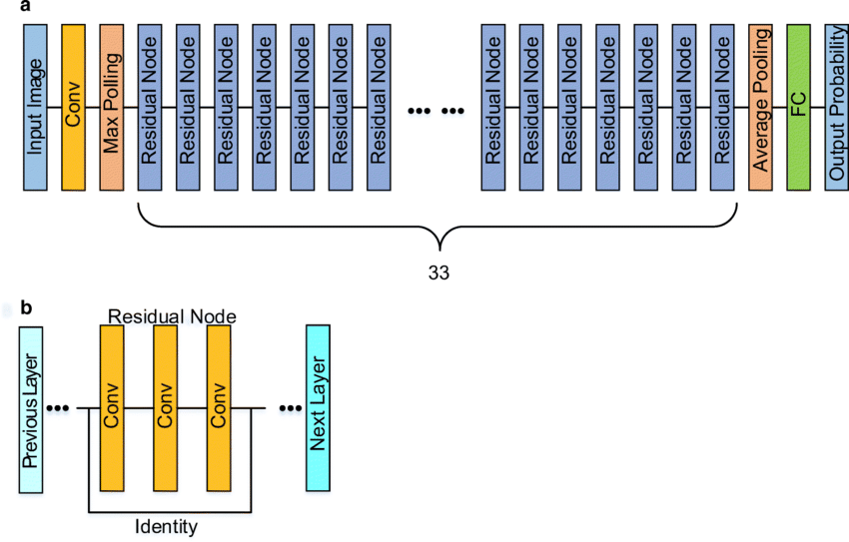
Used Pretrained model(ResNet 101) Transfer Learning
6

Slide 7
02
MODEL ARCHITECTURE
7

Slide 8
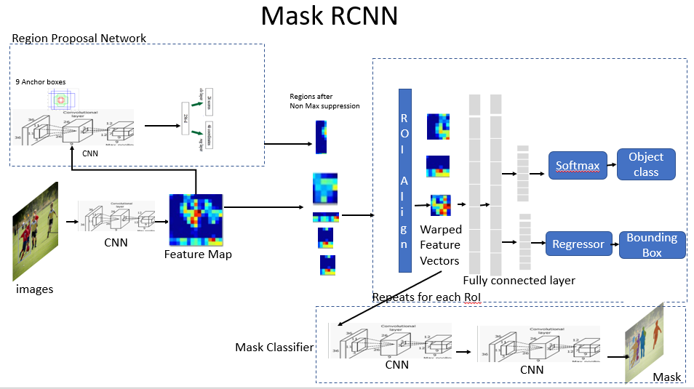
A: Detailed Architecture of Mark R-CNN
9

Slide 9
03
RESULTS
9

Slide 10
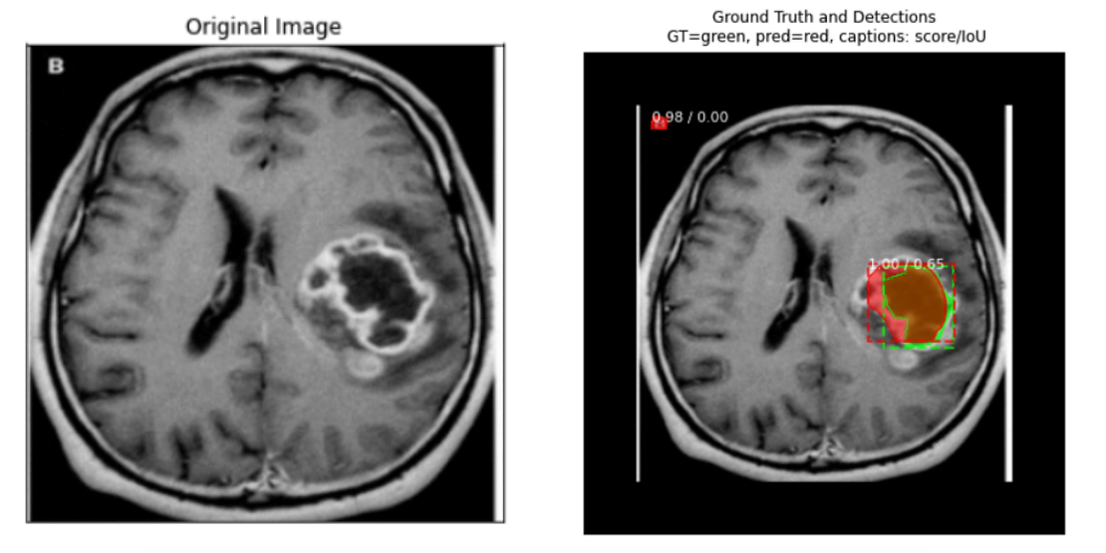
Results
10

Slide 11
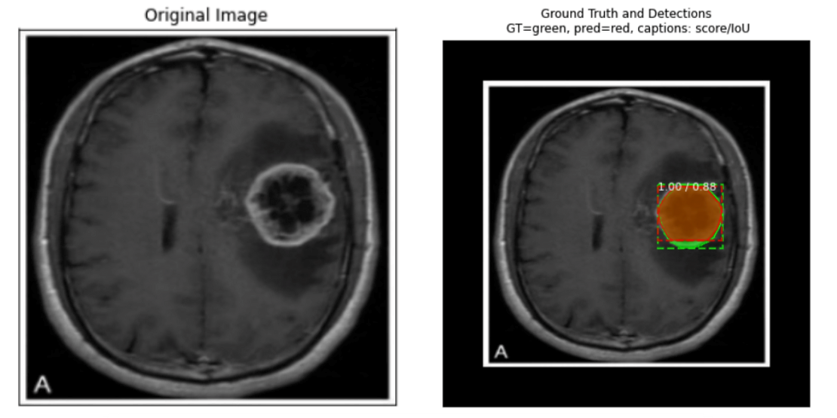
Results
11

Slide 12
04
CHALLENGES FACED AND THEIR SOLUTIONS
High variability in tumor shape and size, this problem is solved using Transfer Learning
Overfitting is solved by regularization techniques
Limited data availability is solved by data augmentation
12

Slide 13
Thank You
Any Questions?
13

